Slide 1

Predicting Cryptocurrencies Exchange Rates Based on Cryptocurrencies News Sentiment Analysis
Maciej Pawlikowski, Hubert Ruczyński,
Bartosz Siński, Adrian Stańdo

Slide 2
Business goals
The goal of this project is to create a system which enables its users to investigate the influence of the latest news articles on exchange rates of cryptocurrencies. Our tool will scrap current exchange rates, and recent news regarding cryptocurrencies in order to perform a sentiment analysis of those messages. Extracted features will be provided into the time-series predictive model that will present estimated exchange rates of selected cryptocurrencies, based on archival data, the most recent trends, and sentiment.
The end users will be able to track current exchange rates, our prediction, and the latest news concerning selected cryptocurrency. This information might help them make the best decision about when to exchange their money. As a result, they may save a lot of money or even find a way to influence main news sources to publish articles that would have positive impact on selected exchange rates.

Slide 3
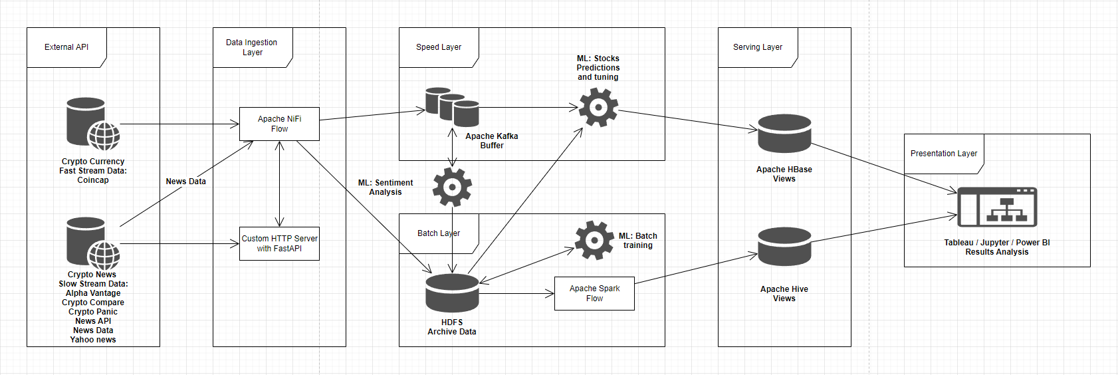
Architecture reminder

Slide 4
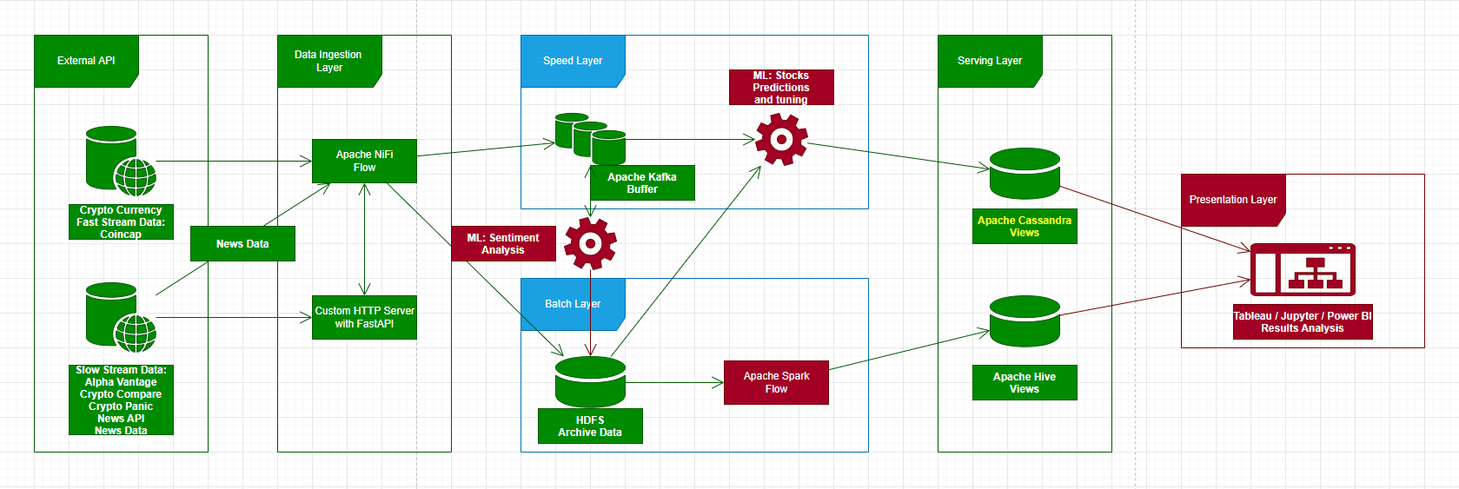
Work progress
Notes:
Dwa pierwsze kroki tak jak ostatnio też pokazywaliśmy działają
Teraz udało nam się postawić Kafkę, HDFS, Cassandrę i Hive
Powiedzieć że potrafimy też zapisywać i wczytywać rzeczy ale ciężko nam przpeorwadzać operacje na streamach danych

Slide 5
Apache services integration
Encountered issues:
Initially, we used Spark 3.5.0, but it couldn’t work properly with Hadoop 3.2.1, where we already saved the data. We had to downgrade to 3.0.0
For a long time we tried to find a Spark-HBase conntector, but it is a really hard task, and we couldn’t find any working solutions. Ideally, we have to compy some files out of the container, add some jar files from the network, and it will work.
We tried switching to a newer HBase version (1.2.6 -> 2.2.6), but it didn’t help us.
We attempted to install Happybase on spark-master docker in order to connect to HBase, but it raised multiple errors, which we couldn’t solve.
Finally, we switched to Cassandra, as it doesn’t require any additional connectors.

Slide 6

Major issues generator…
Don’t let this cute smile deceive you!

Slide 7
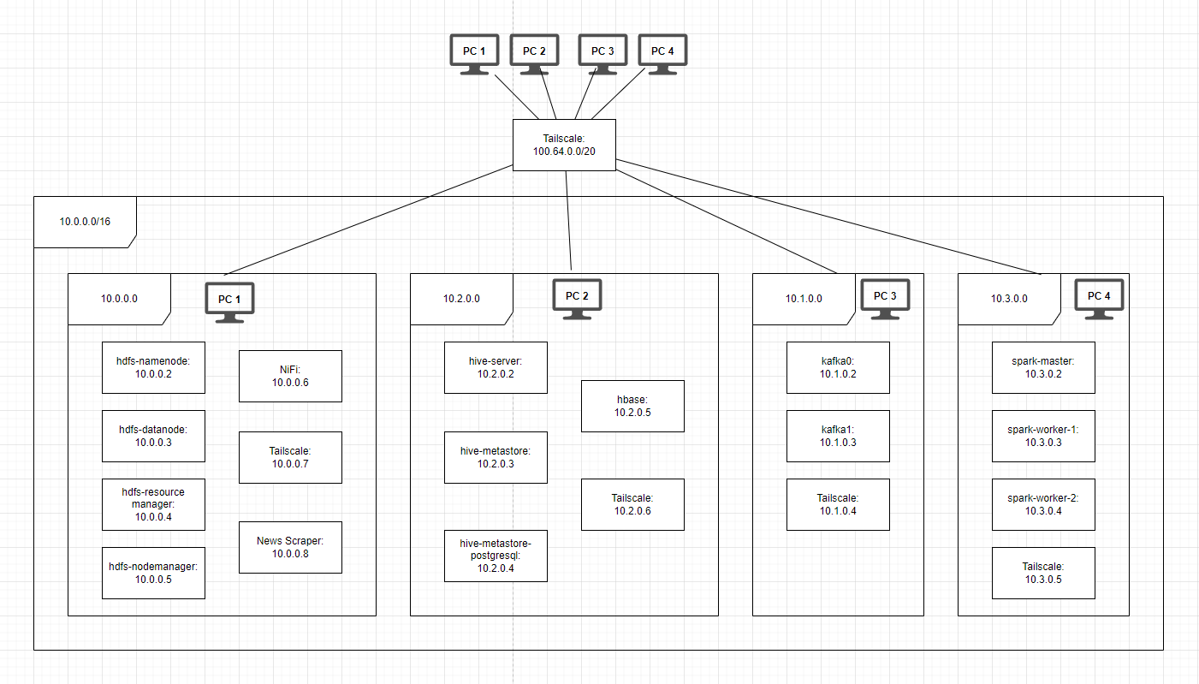
Initial solution

Slide 8
Encountered issues
Docker images immediatly working alone, but not when combined.
Lots of guides for small parts, not a whole system.
Creating route tables for all containers, as the conainers don’t see each other.
The need of writing configuration scripts for all containers, as their operating systems are increadibly raw (lack of ping, or sudo commands).
Mounting the volumes, sometimes requires copying configuration files which are somewhere in the container.
Extremely complex docker-compose configuration files.

Slide 9
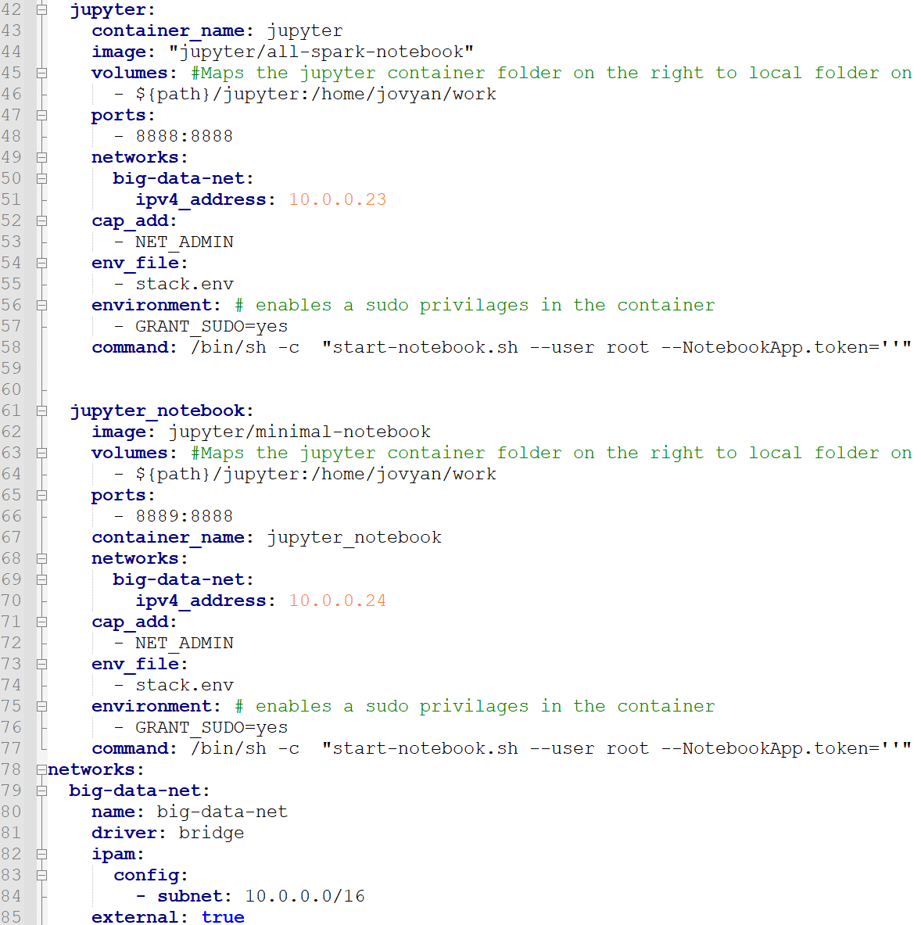
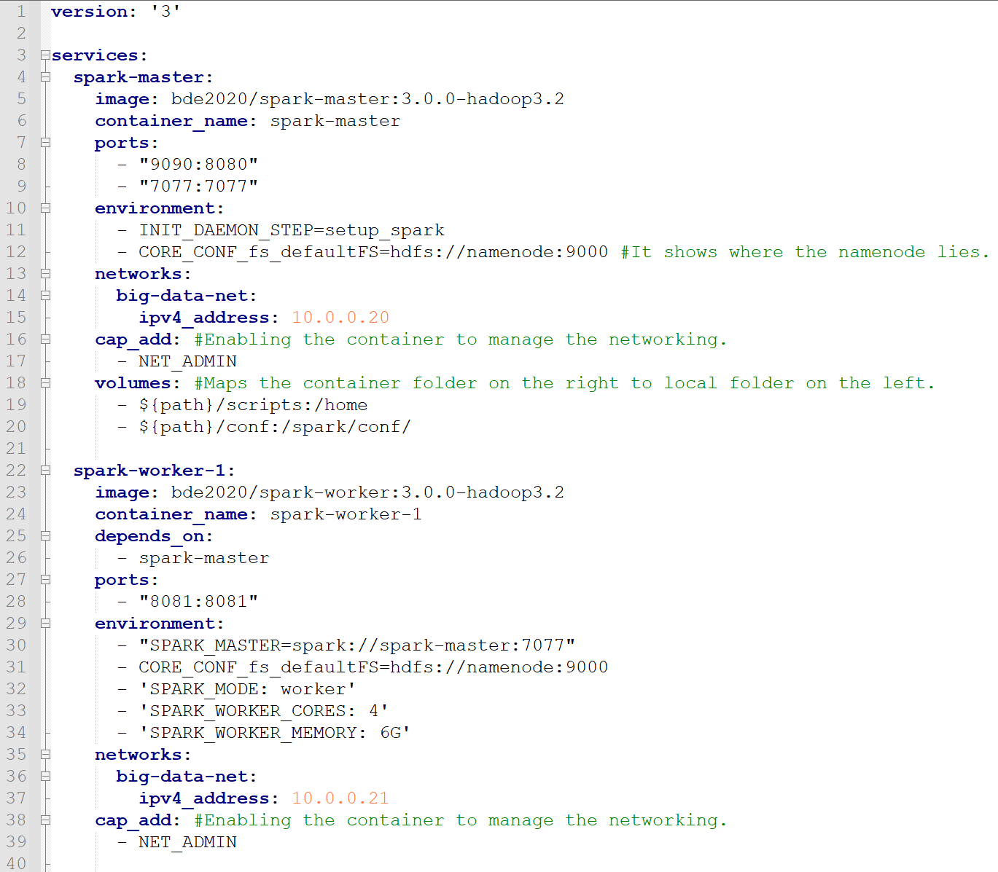
Docker example

Slide 10
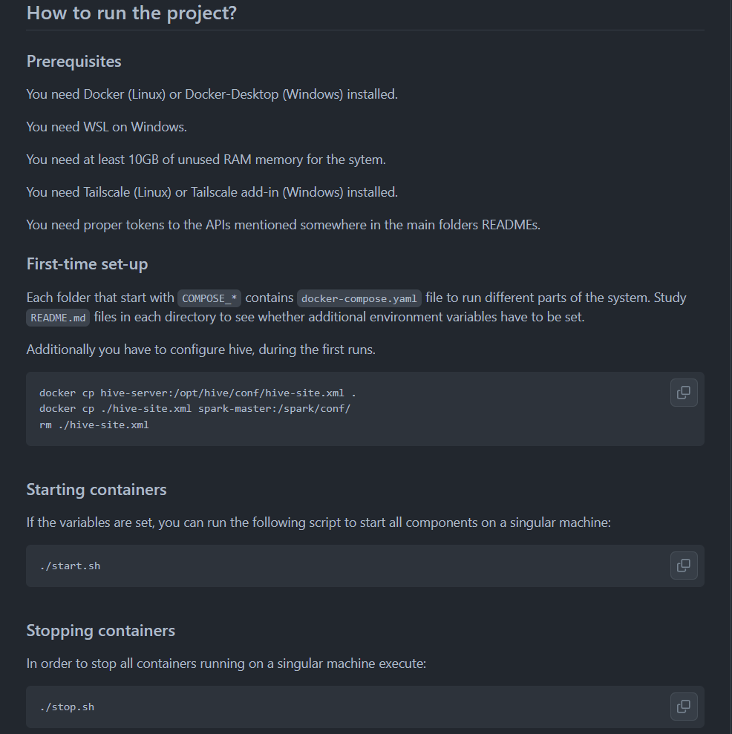
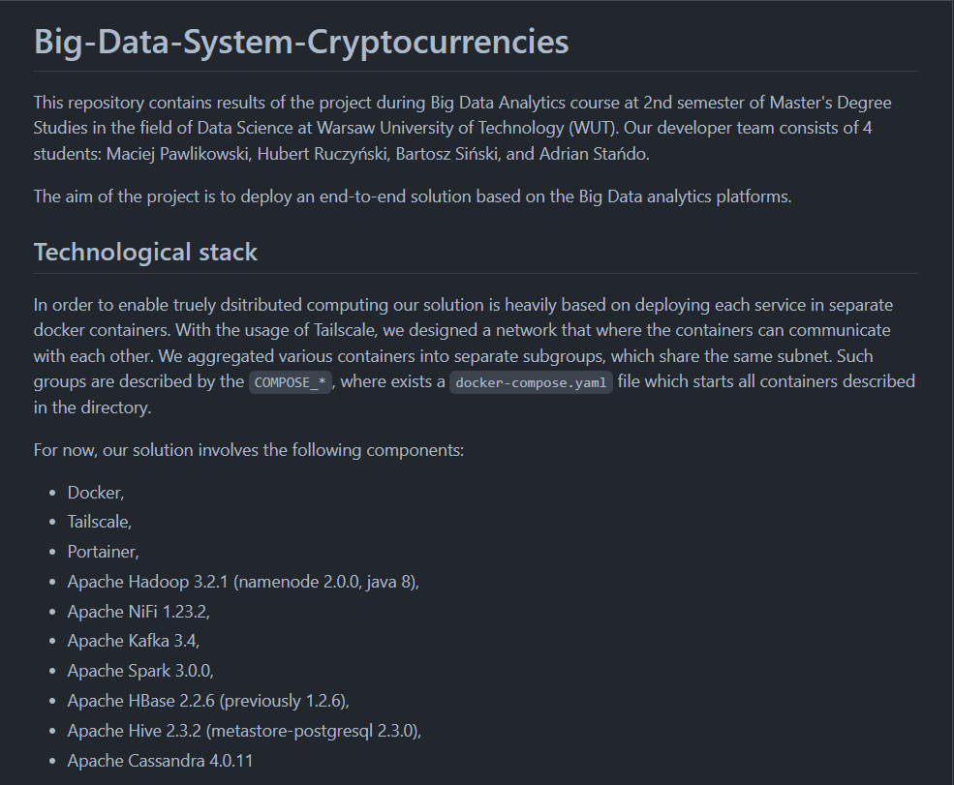
Documentation

Slide 11
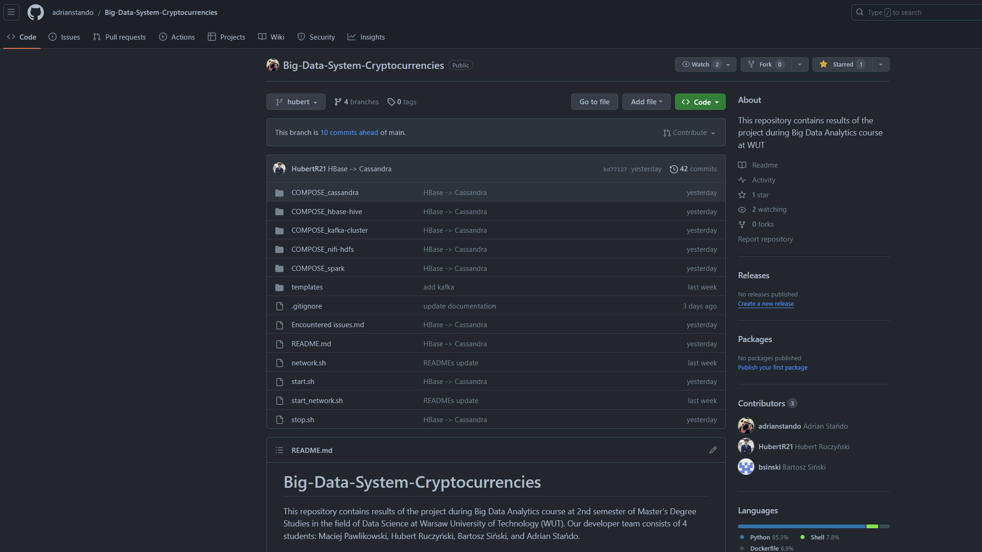

Documentation

Slide 12
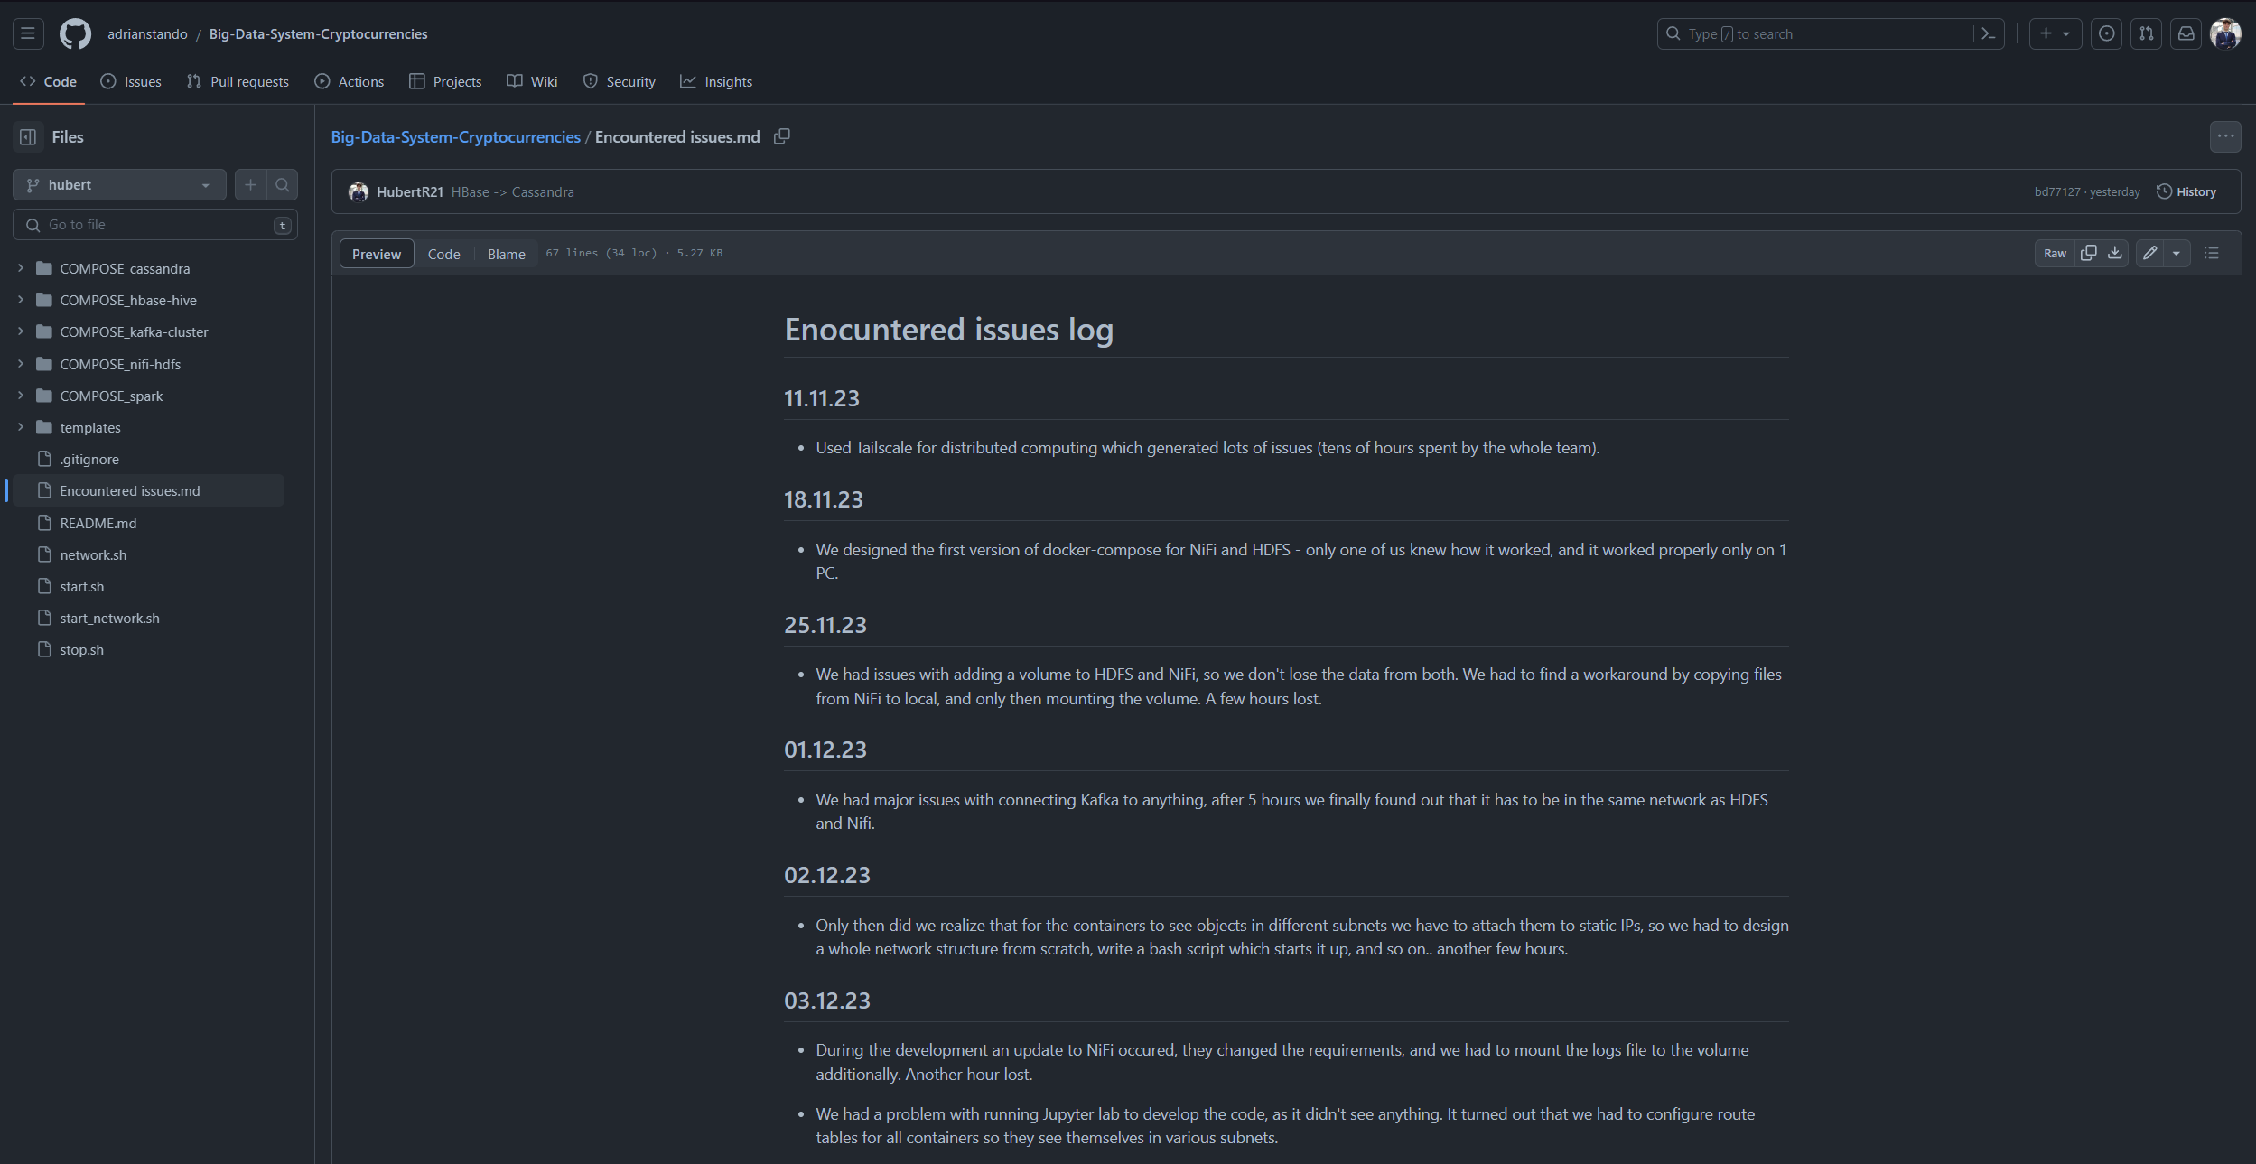
Documentation

Slide 13
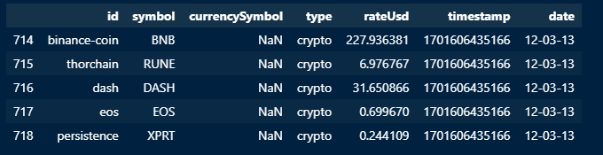
EDA – cryptocurrencies rates
17 unique cryptocurrenices: ('DAI', 'ZEC', 'LTC', 'XPRT', 'DASH', 'CRO', 'QTUM', 'ETH', 'DVPN’, 'BTC', 'USDT', 'BNB', 'WAVES', 'EOS', 'DOGE', 'RUNE', 'BCH’),
14452 records for each of them (different timestamps),
No missing values in meaningful columns.

Slide 14
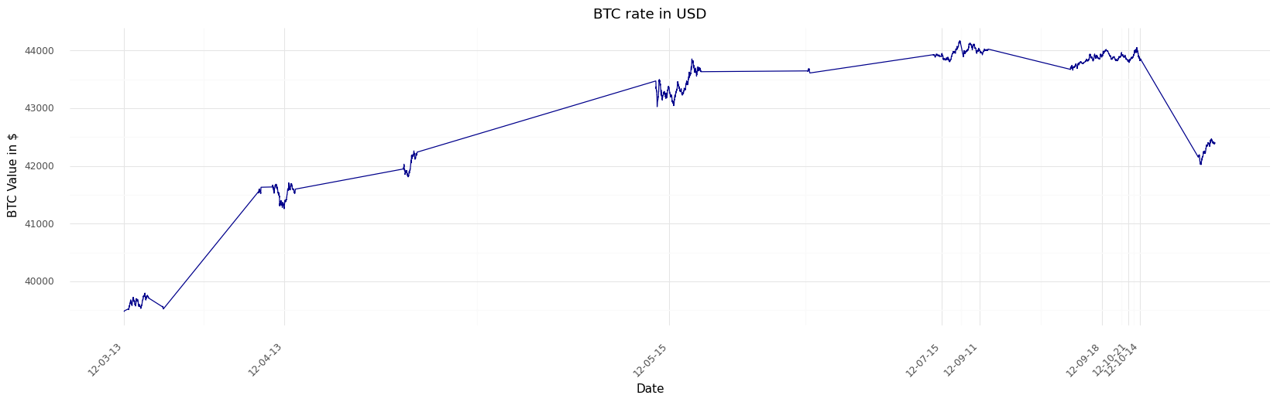
EDA – cryptocurrencies rates

Slide 15
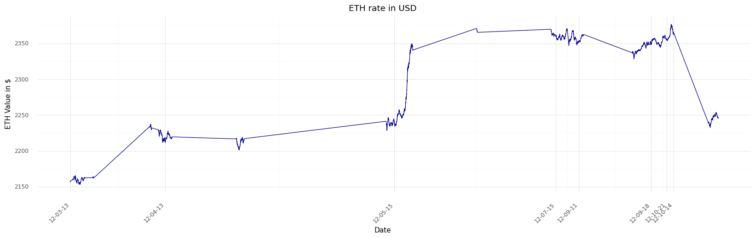
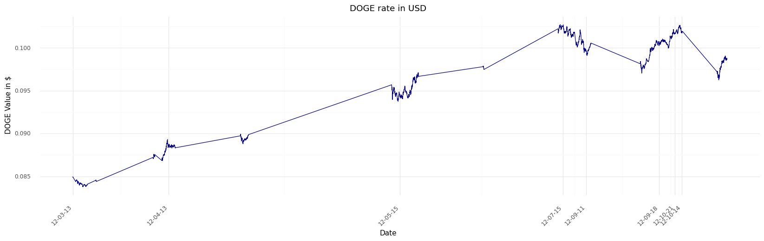

Slide 16
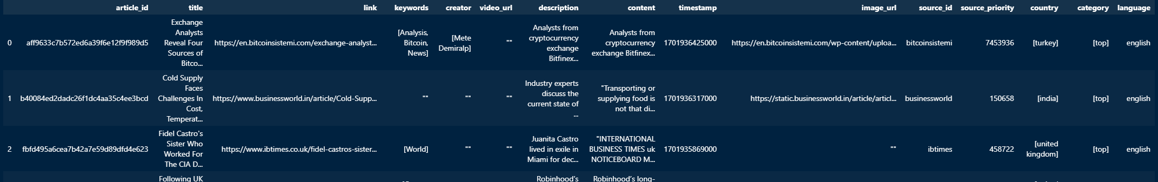
EDA – News data
Datasources which used scrapper have low quality, and we have problems to make them usable.
Nevertheless, most of scrapped data comes from news.io which delivers high quality.
We have 508 English articles with full texts.
E.g. 192 of them mention Bitcoin, 63 Ethereum, and 16 Doge Coin

Slide 17
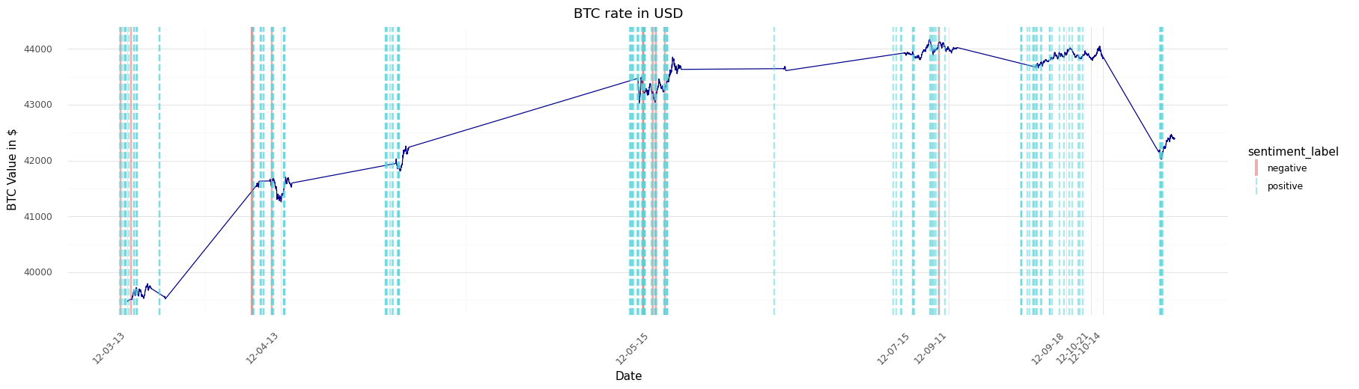
EDA – News data

Slide 18
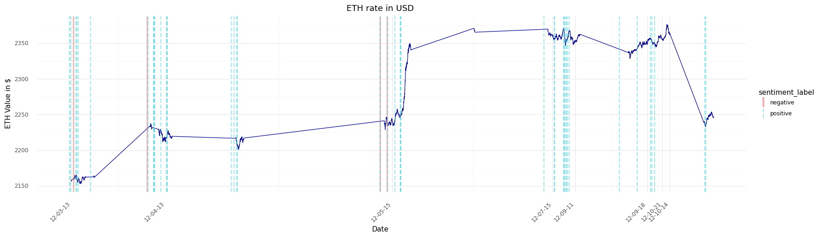
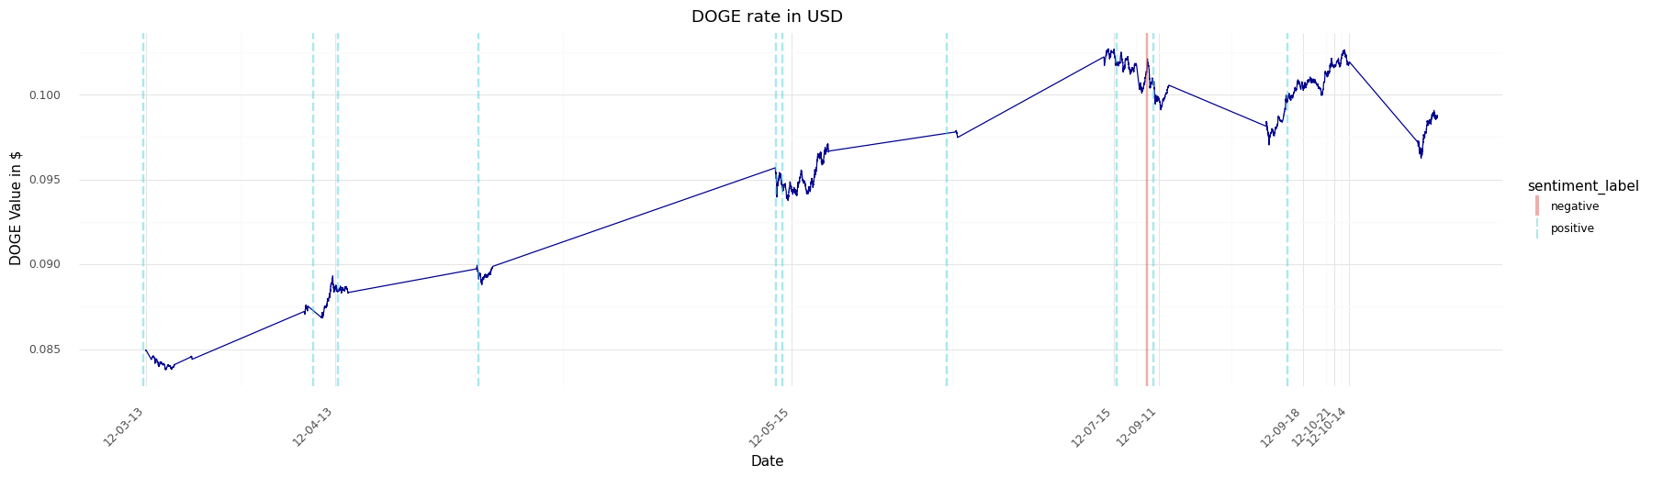

Slide 19
Thank you for attention

